Slide 1
Module 4 Mapping short reads

Slide 3
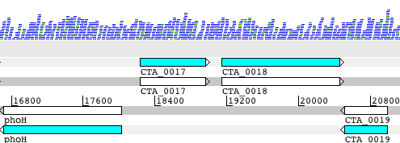
Workflow of re-sequencing, alignment, and in silico analysis
Wet-lab
genome
Break into fragments (~200bp)
paired-end reads
Align reads to reference genome
in silico
FASTQ file
Identify SNPs and INDELs,
*
view in Artemis

Slide 4
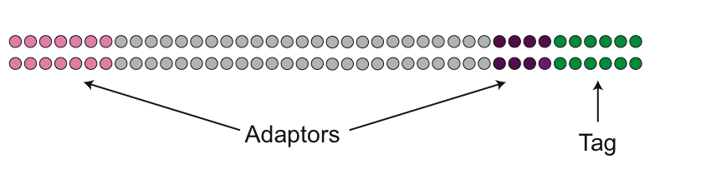
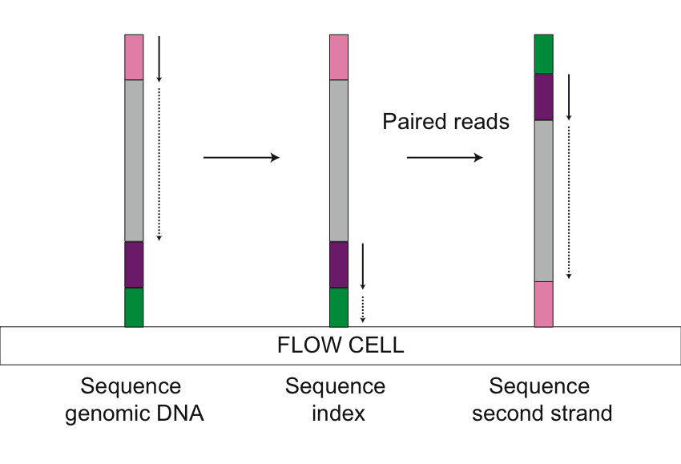
Illumina Sequencing Reads
FASTQ file
@IL22_1561:1:1:1771:914
TTTTTTCAATACAATTTCATCTCTAATTTCAATTCAGCCTAA
+
>>>>7>>>>>>>>>>>>>>>>>>>:>5>>>96>+>>7;>>>>
@IL22_1561:1:1:1222:1105
ATGATATCATCTACACGGTTTAAAAATTCTGGACGGCTGATC
+
>>;>>>>>>>;>>>>>55>>>>>>>>>>>>+2>>8>>>>>57
@IL22_1561:1:1:1438:709
ACACCGATGACAATAATTGTTCCAATATCTGTAACAAAGCTA
+
<<<<<2<<2<<<<<<<<<)'<<<<<<<<<<+<;;7<)<<2<<
@IL22_1561:1:1:1671:1462
TGCAAGAACATTAGACAACGTATCTTCAATCGTTTATACAAG
+
>>7>:>:>>7>>7/:>>>7/.7>>>>>57>>0>>>>>>7>>>
@IL22_1561:1:1:1168:891
AATGGAAATCAAACTATAACTTCAACACTAAATGAGAAGCTA
+
>>>:7>>>>>>>>>>>>>>>>>>>>>>>>>>>>0>>>>>>>>
@IL22_1561:1:1:1097:1281
TAAAAGTATAACTTTCCATCACCAAAGTCAGAATTTACATCG
+
>>>>>>>>>>>>>>>>>>>>>>>>8>8>>>>>>>>>>>>>>>
TAG Strain
CGTGAT HGSA942
ACATCG 3HK
GCCTAA CHI59
TGGTCA CHI61
CACTGT BK2491
ATTGGC TUR9
GATCTG HU25
TCAAGT HU109
CTGATC HSJ216
AAGCTA FFP103
GTAGCC ICP5062
TACAAG GRE4

Slide 5
Mapping Illumina sequence data
Resequencing – takes a set of short reads and maps these
onto a reference genome
@IL24_5151:3:1:1553:916#9/1
NAAACTACTTACACCCACTCAGGACACCAGGGACATCATTGCTGACGCCACGGCCTCACAGTGCTGAGCTGATGAT
+
$705291596=>>>>>=>=>=>==>>===>535:6=>=>>>=>==5:;318656:===991/1,-0,0015204.1
@IL24_5151:3:1:2173:904#9/1
NTTTTAACCGTACTTTCACCAGGATTATCGCAGGCGGATTCCTGGTGATTAATTTCAAAAAATAGCGTTTAATCCA
+
$948883999>==>>>>=>>=>>9>>>==>===>=>==>>:;:::===>=55:88>==>9:0;;:===>>==>>>5
@IL24_5151:3:1:2948:912#9/1
NCCACCAGACACTGTCCGCAACCCCGGTAAGGGGCCAACGTTAGAACATCAAACATTAAAGGGTGGTATTTCAAGG
+
>reference sequence
ATTGAACGCTGGCGGCAGGCCTAACACATGCAAGTCGAGCGGCAGCGGGAAGTAGTTT
TACTTTGCCGGCGAGCGGCGGACGGGTGAGTAATGTCTGGGAAACTGCCTGATGGAGG
GATAACTACTGGAAACGGTAGCTAATACCGCATGACCTCGTAAGAGCAAAGTGGGGGAC
TTCGGGCCTCACGCCATCGGATGTGCCCAGATGGGATTAGCTAGTAGGTGGGGTAATGG
TCACCTAGGCGACGATCCCTAGCTGGTCTGAGAGGATGACCAGCCACACTGGAACTGAG
CACGGTCCAGACTCCTACGGGAGGCAGCAGTGGGGAATATTGCACAATGGGCGCAAGC
GATGCAGCCATGCCGCGTGTGTGAAGAAGGCCTTCGGGTTGTAAAGCACTTTCAGCGAG
AGGAAGGCAGTCGTGTTAATAGCACGATTGATTGACGTTACTCGCAGAAGAAGCACCGGC

Slide 6
Resequencing and mapping
aims to capture information on:
Single Nucleotide Polymorphisms (SNPs),
insertions and deletions (indels)
Copy Number Variants (CNVs) between variants of the same bacteria.
As sequences diverge from the reference, mapping becomes progressively less effective

Slide 7
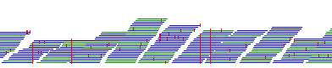
What can you can do with mapping ?
Phylogenetics
SNP calling
Looking at copy number
Looking at presence/absence
Checking for errors

Slide 8
Paired-end sequence reads in FASTQ file *
Map against reference *
Create alignment
Call SNPS and create pseudogenomes *
Construct and interpret phylogeny
Extract variable sites
and convert format
*do for each isolate

Slide 9
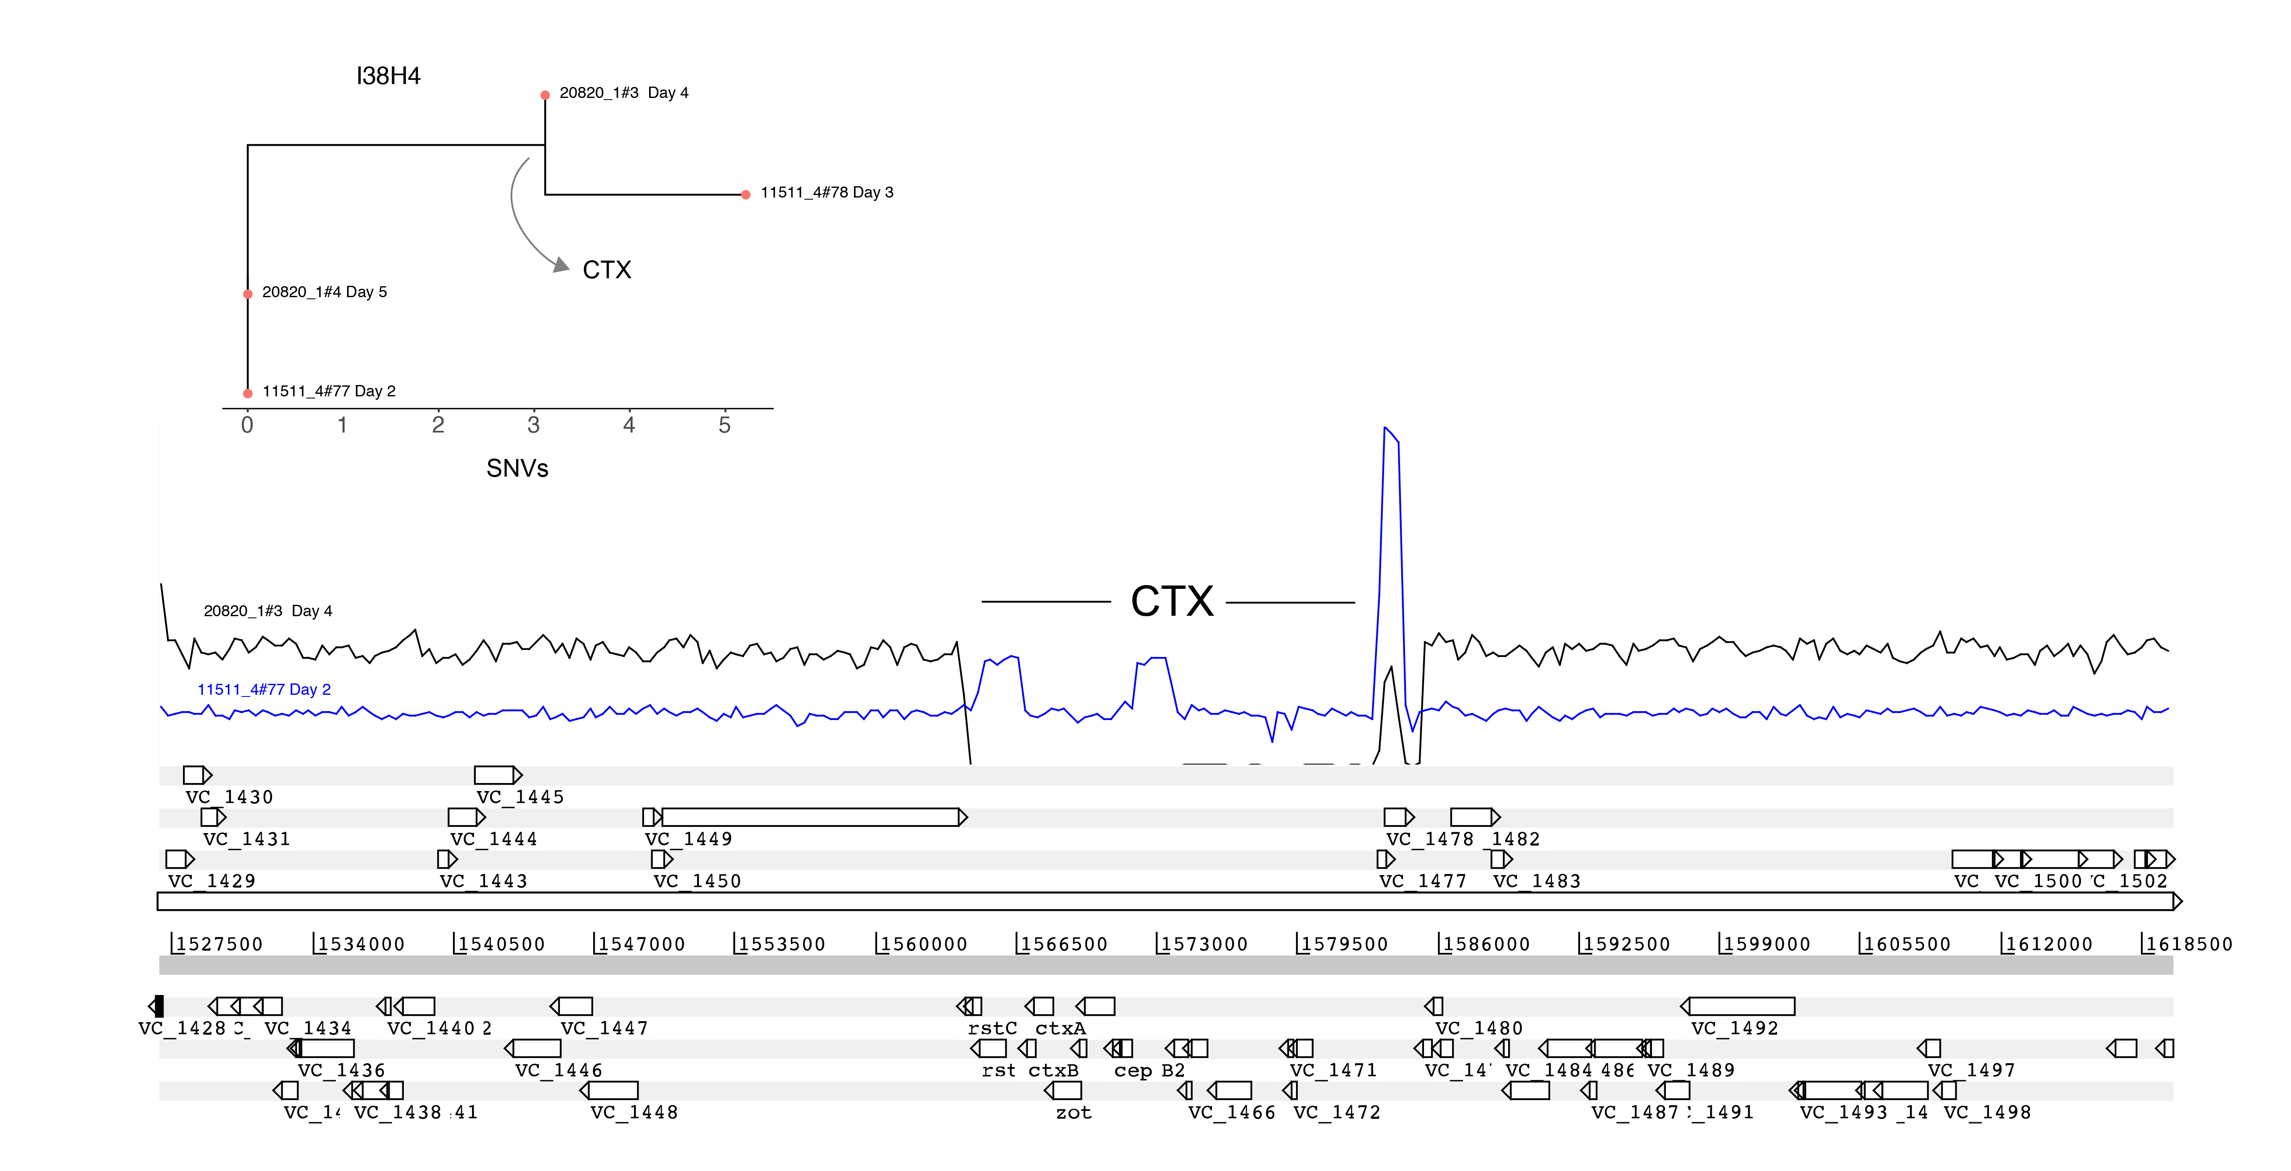
Gene presence / absence

Slide 10
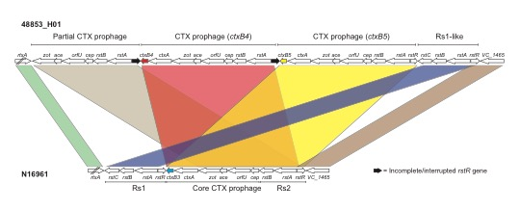
Copy number variation

Slide 11
There are lots of options
for mapping!
https://www.ebi.ac.uk/~nf/hts_mappers

Slide 12
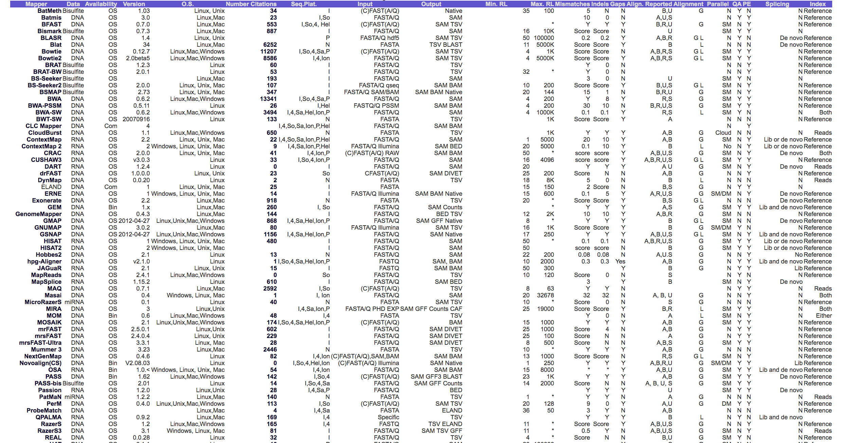
Comparison of different mappers
https://www.ebi.ac.uk/~nf/hts_mappers

Slide 13
Good general aligners
bwa
Fast, sensitive and easy to use!
bowtie2
Splice-aware aligners for RNA-seq
STAR
HISAT2

Slide 16
You must think carefully about what reference genome you want to use! You won’t find things in your sample that are not in the reference!

Slide 17
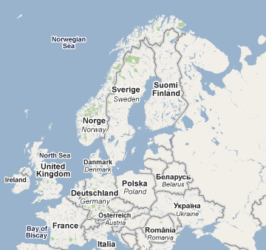
The Swedish Story
Prior to 2006, C. trachomatis in Sweden was following the same pattern as in the UK
In 2006, across Sweden there was a reported 2% drop in cases
Initially thought this was a good thing
Notes:
* Editorial
A new genetic variant of Chlamydia trachomatis
1. Björn Herrmann
1. Correspondence to: Björn Herrmann Department of Clinical Microbiology, Uppsala University Hospital, S-751 85 Uppsala, Sweden; bjorn.herrmann@medsci.uu.se
* Chlamydia trachomatis
* Sweden
A thrilling story in Sweden, with global impact
A new variant of Chlamydia trachomatis was discovered in Sweden in 2006. This variant contains a mutant sequence that cannot be detected with either the Abbott m2000 (Abbott Diagnostics, Chicago, IL, USA) or Cobas Amplicor/TaqMan48 (Roche Diagnostics, Basel, Switzerland) systems. 1 The first description reported that the new variant constituted 13% of all detected chlamydia infections (from mid-September to October 2006) in the county of Halland (south west of Sweden). It soon became apparent that the proportion was higher and that the new variant had spread widely in Sweden. We now know that in the counties that have used the Abbott or Roche test systems during the past year or so the new variant accounts for 20% to 65% of all detected chlamydia cases. In local areas, as many as 78% of all cases have been found to have the mutation (Britta Loré, personal communication).

Slide 18
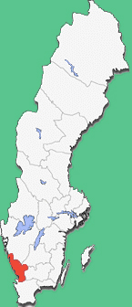
The County of Halland, Sweden
In Halland County there was a 25% decrease in diagnosed C. trachomatis infections from Nov 05 - Aug 06
Notes:
* Editorial
A new genetic variant of Chlamydia trachomatis
1. Björn Herrmann
1. Correspondence to: Björn Herrmann Department of Clinical Microbiology, Uppsala University Hospital, S-751 85 Uppsala, Sweden; bjorn.herrmann@medsci.uu.se
* Chlamydia trachomatis
* Sweden
A thrilling story in Sweden, with global impact
A new variant of Chlamydia trachomatis was discovered in Sweden in 2006. This variant contains a mutant sequence that cannot be detected with either the Abbott m2000 (Abbott Diagnostics, Chicago, IL, USA) or Cobas Amplicor/TaqMan48 (Roche Diagnostics, Basel, Switzerland) systems. 1 The first description reported that the new variant constituted 13% of all detected chlamydia infections (from mid-September to October 2006) in the county of Halland (south west of Sweden). It soon became apparent that the proportion was higher and that the new variant had spread widely in Sweden. We now know that in the counties that have used the Abbott or Roche test systems during the past year or so the new variant accounts for 20% to 65% of all detected chlamydia cases. In local areas, as many as 78% of all cases have been found to have the mutation (Britta Loré, personal communication).

Slide 19
The Swedish story
It was noticed that counties using the NAATs (Abbott / Roche) diagnostic system showed a drop in C. trachomatis cases in 2006
Halland County showed the greatest drop
Counties using other diagnostic methods (BecktonDickinson) still showed an increase in cases, in line with that of previous years
The obvious conclusion was that the NAATs was missing a subset of infections
Halland County Like most places had dropped the dual site PCR for the cheaper and apparently just as accurate single site plasmid PCR.

Slide 20
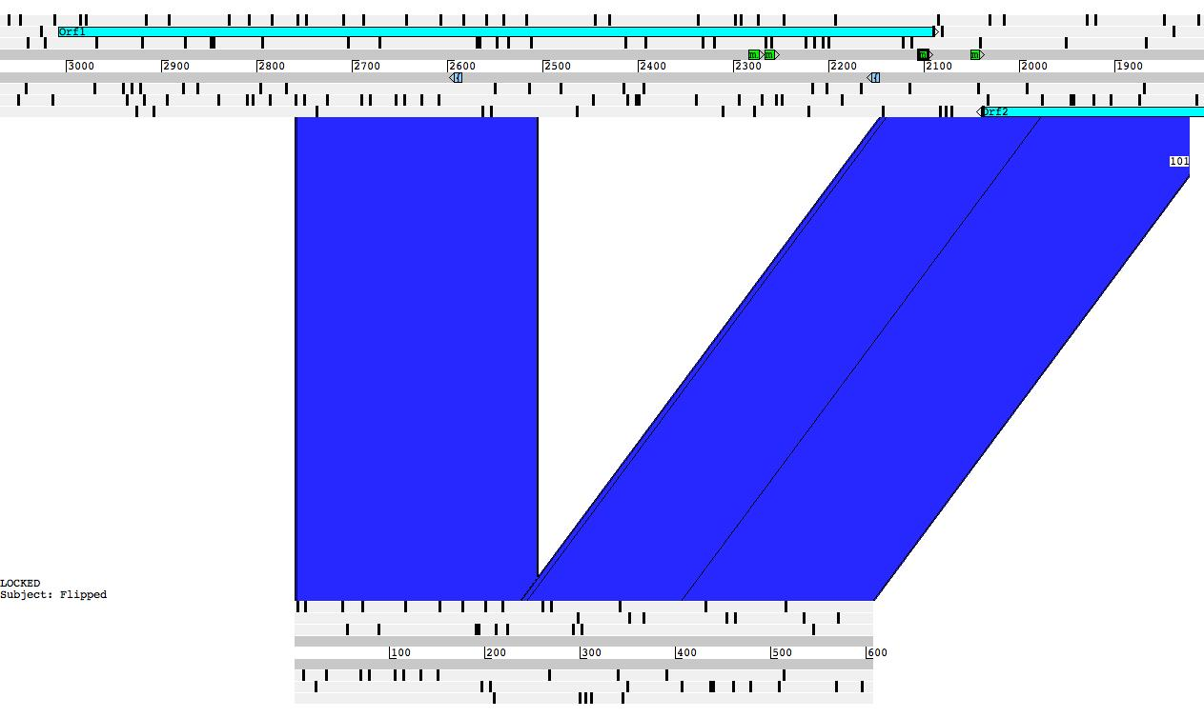
Sequencing pSW2 (nvCT)
nvCT

